Slide 1



Module 2. Lesson 2.
Interface design
Link to guidelines

Slide 2

Module 2. Lesson 2. Interface design
Discussion:
Test application

Slide 3
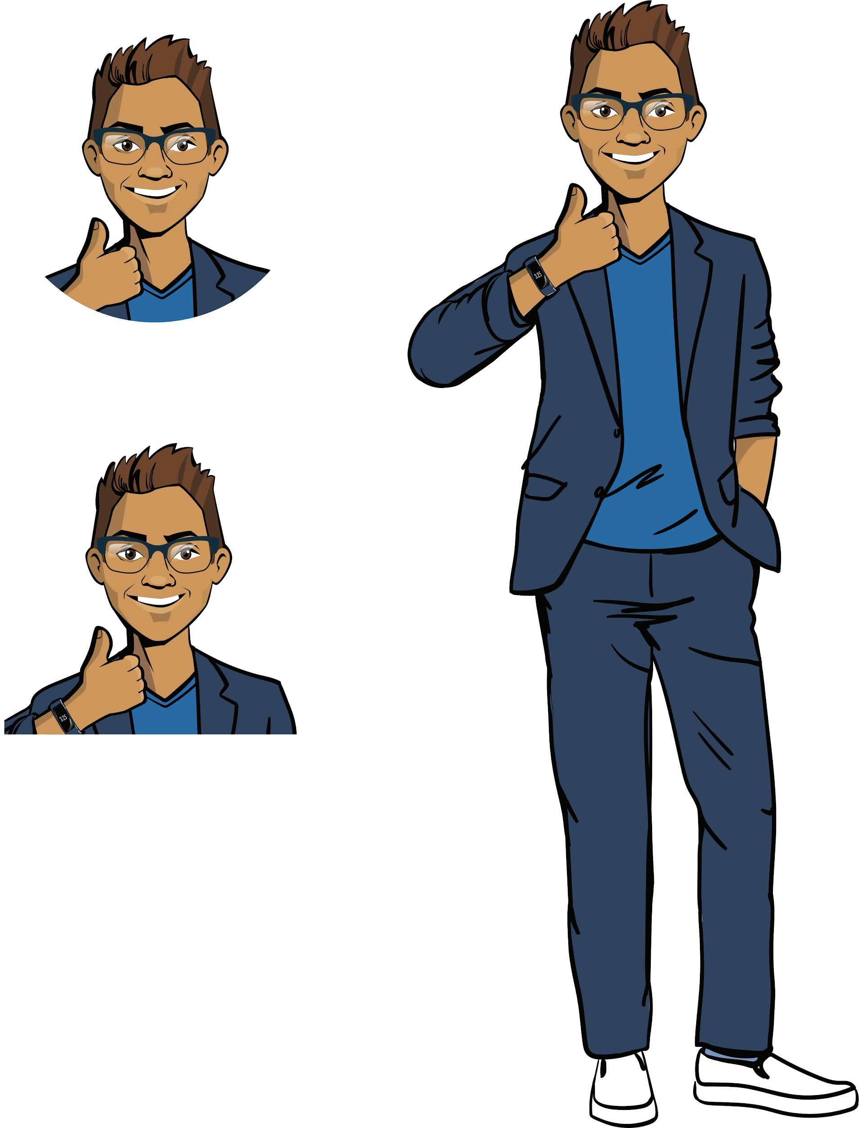

The client appreciated your work
The creators of the Crazy People YouTube channel and their subscribers really liked the program from ProTeam. Now they want to run another competition with prizes.
The finalists of the competition will have to answer questions about the Crazy People channel, so the YouTubers need an application with questions that will display messages about the prizes people win.
Ready to get started?
Discussing
work tasks
Cole,
senior developer

Slide 4
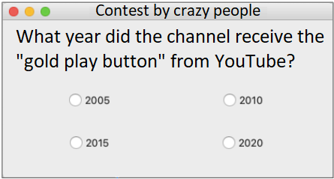
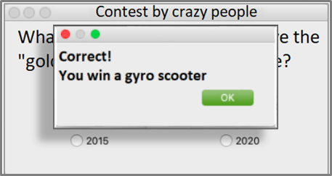

Let’s look at the task
Product type: windowed application.
Functionality:
display a test question with answer options;
display a prize depending on the answer selected.
Discussing
work tasks
What tools do we need to complete such a request?

Slide 5
Let’s look at the task
The "Competition" application
Application functionality
Application interface
Nothing complicated.
Creating a question window with a choice of possible answers.
Arranging the widgets in the question window.
Processing mouse events with interface elements.
Displaying a result window depending on the answer.
Discussing
work tasks

Slide 6
Let’s look at the task
The "Competition" application
Application functionality
Application interface
Nothing complicated.
Creating a question window with a choice of possible answers.
Arranging the widgets in the question window.
Processing mouse events with interface elements.
Displaying a result window depending on the answer.
Discussing
work tasks
We need to learn new widgets and better understand layouts.

Slide 7
The goal of the work day is
to learn new widgets in the PyQt library and create an app for a trivia competition.
Today you will
Discussing
work tasks
review what a class, class constructor, windowed application, and widgets are;
learn how to arrange widgets in layouts and combine multiple layouts into one;
create a new PC app!

Slide 8

Module 2. Lesson 2. Interface design
Qualifications

Slide 9
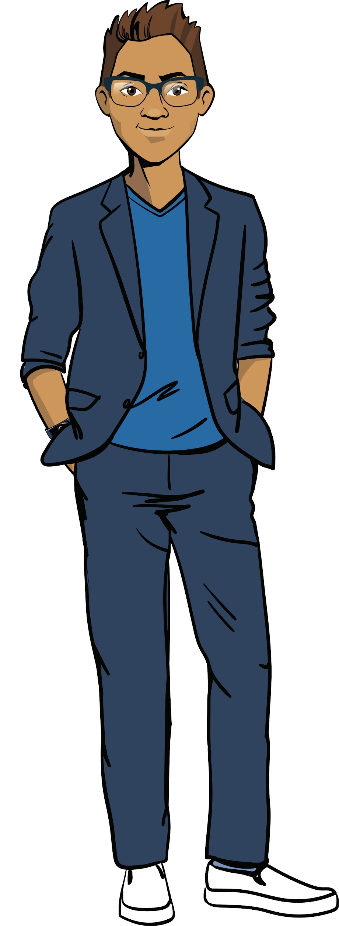
Show your knowledge of
classes and the PyQt library.
Qualifications

Slide 10
What is an object?
Property? Method?
What is a class?
Do you know ready-made object classes?
Qualifications

Slide 11
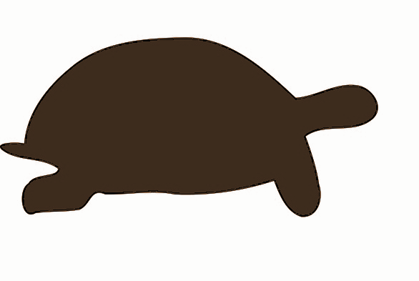
A property
is a variable inside an object.
A method
is a function inside an object.
It’s a turtle
Qualifications
Object
Properties + Methods
Object class
Our knowledge about all these objects

Slide 12
What does a class consist of?
How do we create a class?
Qualifications

Slide 13
Creating classes
To create a class, we need to do the following:
list the properties in the constructor that define the characteristics of an instance of the class;
list the methods for managing an instance.
class Application():
def __init__(self, title_text):
self.title = title_text
def print_info (self):
Class name
Qualifications
Value
Property name
Value
Method name
Action with object and properties
What is a constructor?
What is self?
Action with object and properties

Slide 14
Creating classes
To create a class, we need to do the following:
list the properties in the constructor that define the characteristics of an instance of the class;
list the methods for managing an instance.
class Application():
def __init__(self, title_text):
self.title = title_text
def print_info (self):
Class name
A special constructor function that creates an instance of a class with the specified properties.
Qualifications
Value
Property name
Value
Method name
Action with object and properties
__init__
Action with object and properties
Two underscores.

Slide 15
Creating classes
To create a class, we need to do the following:
list the properties in the constructor that define the characteristics of an instance of the class;
list the methods for managing an instance.
class Application():
def __init__(self, title_text):
self.title = title_text
def print_info (self):
Class name
Qualifications
self is a parameter indicating the object to which the method is applied.
self.property is a property of the object to which the method is applied.
Value
Property name
Value
Method name
Action with object and properties
Action with object and properties

Slide 16
What is a windowed application?
What does it consist of?
Qualifications

Slide 17
A windowed application
is a computer program that interacts with the user through a graphical interface.
A standard windowed application consists of the following:
a main window,
controls (widgets),
additional windows (optional).
Qualifications
Main window
Additional window
Widgets

Slide 18
How do we create an app?
What widgets do you know?
Qualifications

Slide 19
PyQt5 ––
is a cross-platform library for building windowed applications.
from PyQt5.QtCore import Qt
from PyQt5.QtWidgets import QApplication, QWidget, QPushButton, QLabel, QVBoxLayout
Object | Designation
Application | QApplication
Application window | QWidget
Label | QLabel
Button | QPushButton
Vertical guide line | QVBoxLayout
Qualifications

Slide 20
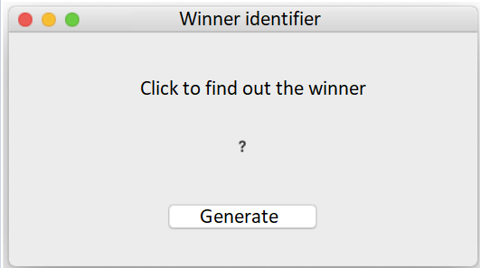
from PyQt5.QtCore import Qt
from PyQt5.QtWidgets import QApplication, QWidget, QPushButton, QLabel, QVBoxLayout
app = QApplication([])
main_win = QWidget()
main_win.setWindowTitle('Winner Identifier')
button = QPushButton('Generate')
text = QLabel('Click to find out the winner')
winner = QLabel('?')
line = QVBoxLayout()
line.addWidget(text, alignment = Qt.AlignCenter)
line.addWidget(winner, alignment = Qt.AlignCenter)
line.addWidget(button, alignment = Qt.AlignCenter)
main_win.setLayout(line)
main_win.show()
app.exec_()
Qualifications
Example of an application implemented earlier.

Slide 21
What is event handling?
How do we handle mouse events?
Qualifications

Slide 22
Event handling (button clicking)
Describe actions when clicking on a button in a separate processor function.
Use a command to link the function and the widget.
def show_winner():
Qualifications
button.clicked.connect(show_fun_title)
THE FUNCTION IS DESCRIBED SEPARATELY
NAME OF THE PROCESSOR FUNCTION WHICH THE BUTTON RESPONDS TO

Slide 23
Qualifications confirmed!
Great, you are ready to brainstorming and work on your tasks!
Qualifications

Slide 24

Module 2. Lesson 2. Application interface design
Brainstorming:
Object-oriented programming

Slide 25
PyQt library structure
The PyQt library has a complex hierarchical structure.
Some classes have a shared ancestor class, so their instances have similar properties and methods.
To be able to use the PyQt tools in a meaningful way, let’s learn more about inheritance in object-oriented programming.
QtCore
QtWidgets
. . .
Brainstorming
The Qt module:
constants and flags which determine how the window looks
The QApplication, QWidget, QLabel, and QVBoxLayout modules:
widgets and how they are arranged

Slide 26
Classes and subclasses
If we think of examples of classes from real life, we will find that some classes are "descendants" of other classes.
all buttons are widgets
all cats are animals
all desks are tables
Brainstorming
all comets are celestial bodies
all cars are vehicles
A
B

Slide 27
Inheritance
Class inheritance helps us transfer all the skills previously written for a more general class into another, more private class, the inheritor class.
A
Properties
Methods
Properties
Methods
B
+
Properties
Methods
Brainstorming
Inheritor class
Superclass
A
class A is nested within class B
B

Slide 28
Superclass and inheritor class
If the super class is already written, then,
to create an inheritor class, we will need to do the following:
when creating the inheritor, specify the name of the superclass;
add the necessary methods to the inheritor class;
class Application( ):
def __init__(self, ):
super().__init__( )
def print_info (self):
Inheritor name
Superclass name
Brainstorming
Value
Option in which no new properties are introduced.
The inheritor class is only supplemented with a new method.
Value
Method name
Action with object and properties

Slide 29
Superclass and inheritor class
If the super class is already written, then,
to create an inheritor class, we will need to do the following:
when creating the inheritor, specify the name of the superclass;
add the necessary methods to the inheritor class;
class Application( ):
def __init__(self, ):
super().__init__( )
def print_info (self):
Inheritor name
Superclass name
Brainstorming
Value
super refers to the superclass.
The inheritor constructor works like a superclass constructor.
Value
Method name
Action with object and properties

Slide 30
Superclass and inheritor class
If the super class is already written, then,
to create an inheritor class, we will need to do the following:
when creating the inheritor, specify the name of the superclass;
add the necessary methods to the inheritor class;
create an inheritor constructor.
class Application( ):
def __init__(self, , ):
super().__init__( )
self. =
def print_info (self):
Inheritor name
Superclass name
Brainstorming
Value
Value
Value
Option in which new properties are introduced.
The constructor adopts the properties of the superclass and adds a new one.
New property
Value
Method name
Action with object and properties

Slide 31
Creating classes
Example (for console). Application and Mobile Application.
The Application class stores information about the application’s name, description, and size.
Let's create an inheritor class called Mobile Application with a new property and method.
class Application():
def __init__(self, title_text, description_text, volume_num):
self.title = title_text
self.description = description_text
self.volume = volume_num
def print_info(self):
print('Application', self.title)
print('Description:', self.description)
print('Application size:', self.volume)
Brainstorming

Slide 32
class Application():
def __init__(self, title_text, desription_text, volume_num):
#...
def print_info(self):
#...
class MobileApplication(Application):
#constructor of the inheritor class with a new field
def __init__(self, title_text, desription_text, volume_num, system_type_text):
super().__init__(title_text, desription_text, volume_num)
self.system_type = system_type_text
#new method of the inheritor class
def setup_application(self):
print('Installation of', self.system_type, 'the application is complete')
mobile_app = MobileApplication('My Notes', 'Smart notes and checklists', 50, 'Android')
mobile_app.print_info()
mobile_app.setup_application()
Brainstorming

Slide 33
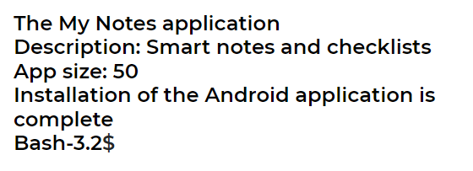
class Application():
def __init__(self, title_text, description_text, volume_num):
#...
def print_info(self):
#...
class MobileApplication(Application):
def __init__(self, title_text, desription_text, volume_num, system_type_text):
#...
def setup_application(self):
#...
mobile_app = MobileApplication('My Notes', 'Smart notes and checklists', 50, 'Android')
mobile_app.print_info()
mobile_app.setup_application()
Brainstorming

Slide 34
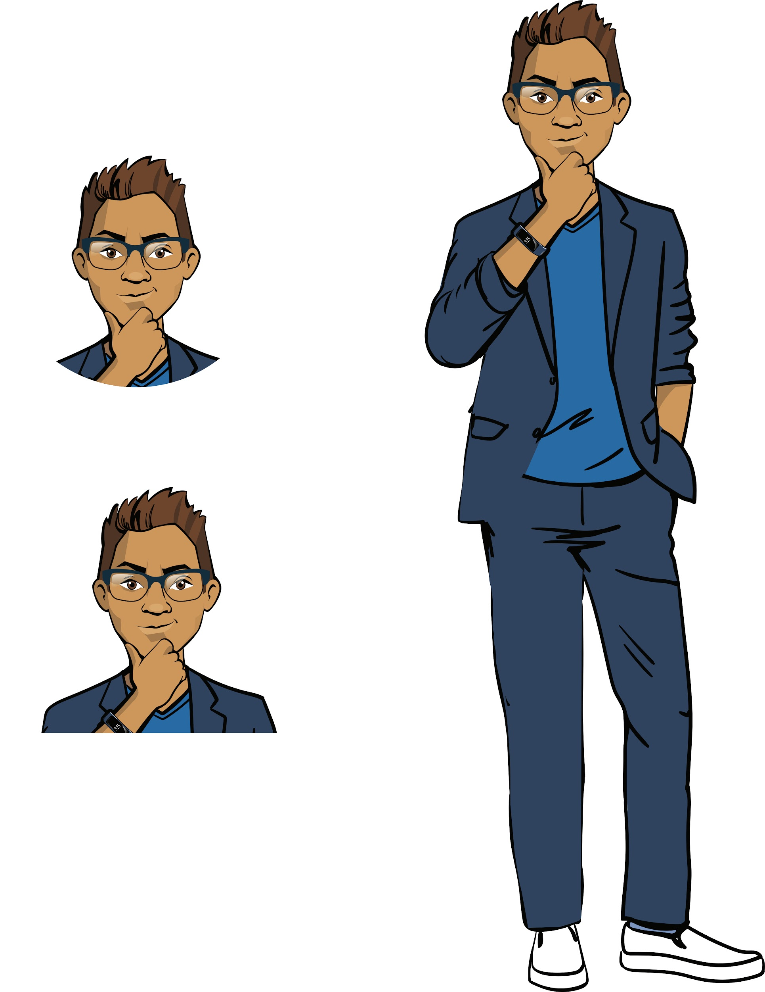
Before continuing, let's check the following:
What will the previous program display if we create an instance of MobileApplication with the following data:
'NeedForSpeed'
'A game in the "Racing" genre'
150
'ios'
Is it possible to create an instance of the Application class in the previous program?
The lead developer suggested adding another version field (app version) to the MobileApplication class. How can we do it?
Brainstorming

Slide 35
Conclusions:
Class inheritance helps us transfer all the skills previously written for a more general class into another, more private class, the inheritor class.
The following is described in the inheritor class:
a new constructor (borrowing superclass properties using the super() method),
new properties (in the constructor),
new methods.
Brainstorming

Slide 36
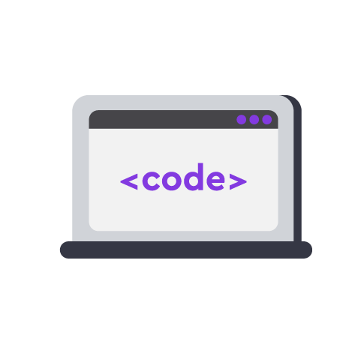
Module 2. Lesson 2. Interface design
Visual Studio Code:
More preparation for creating applications

Slide 37


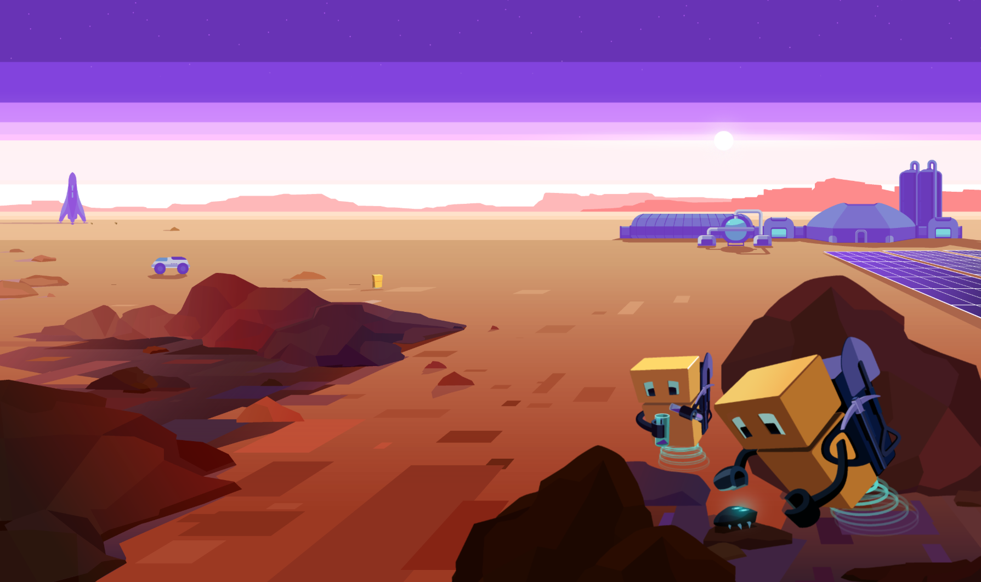
Complete the task in VS Code
VSC. Inheritance
Visual Studio Code from Algorithmics
Preparing to create applications

Slide 38
Module 2. Lesson 2. Interface design
Brainstorming:
Interface design

Slide 39
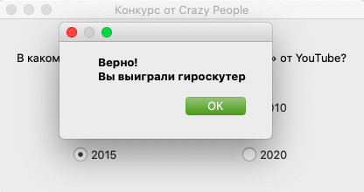
Let’s look at the task
To complete the task, we will need to do the following:
learn new widgets for creating message boxes and radio buttons;
learn how to create > 1 layout and place widgets in them.
Brainstorming

Slide 40
The "Competition" application
Step 1. Creating the necessary widgets.
Object | Designation
Application | QApplication
Application window | QWidget
Label | QLabel
Guide line (vertical, horizontal) | QVBoxLayout, QHBoxLayout
Message window | QMessageBox()
Radio button | QRadioButton
Brainstorming
How do we import the necessary library modules?

Slide 41
Importing PyQt modules
QtCore
QtWidgets
. . .
The Qt module:
constants and flags which determine how the window looks
The QApplication, QWidget, QLabel, and QVBoxLayout modules:
widgets and how they are arranged
Brainstorming
It needs to be imported for the alignment parameter.
It needs to be imported for the corresponding widgets.
from PyQt5.QtCore import Qt
from PyQt5.QtWidgets import (
QApplication, QWidget, QLabel, QVBoxLayout, QHBoxLayout, QMessageBox
)

Slide 42
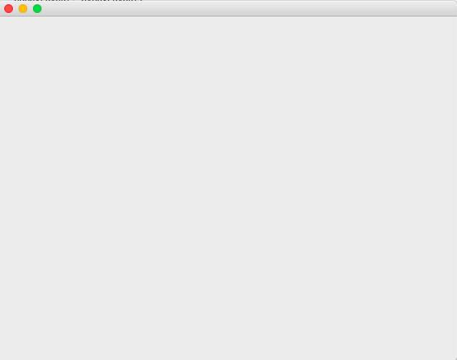
Creating an application and main window
from PyQt5.QtCore import Qt
from PyQt5.QtWidgets import QApplication, QWidget, QPushButton, QLabel, QVBoxLayout
app = QApplication([])
my_win = QWidget()
my_win.show()
app.exec_()
Brainstorming
Don't forget to resize the window and choose where it will appear.

Slide 43
Creating a question and answer options
Answer option:
Method | Purpose
btn_answer = QRadioButton('Signature') | A constructor that creates a "Radio button" type object with a signature.
Question (you already know this widget):
Brainstorming
Method | Purpose
question = QLabel('What year?') | A constructor that creates a "Label" type object with the specified text.

Slide 44
Positioning widgets along a line
Method | Purpose
v_line = QVBoxLayout() | A constructor that creates a "Vertical line" type object.
v_line.addWidget( title, alignment = Qt.AlignCenter ) | A method that adds a widget to the line and positions it in the center.
my_win.setLayout(v_line) | Adds the resulting line and its objects to the application window.
Brainstorming

Slide 45
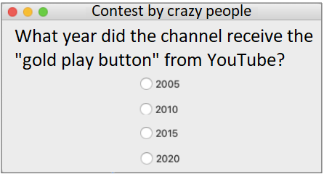
from PyQt5.QtCore import Qt
from PyQt5.QtWidgets import QApplication, QWidget, QPushButton, QHBoxLayout, QVBoxLayout, QLabel, QMessageBox, QRadioButton
app = QApplication([])
main_win = QWidget()
main_win.setWindowTitle('Competition from Crazy People')
question = QLabel('What year did the channel receive the "gold play button" from YouTube?')
btn_answer1 = QRadioButton('2005')
btn_answer2 = QRadioButton('2010')
btn_answer3 = QRadioButton('2015')
btn_answer4 = QRadioButton('2020')
layout_main = QVBoxLayout()
layout_main.addWidget(question, alignment = Qt.AlignCenter)
layout_main.addWidget(btn_answer1, alignment = Qt.AlignCenter)
layout_main.addWidget(btn_answer2, alignment = Qt.AlignCenter)
layout_main.addWidget(btn_answer3, alignment = Qt.AlignCenter)
layout_main.addWidget(btn_answer4, alignment = Qt.AlignCenter)
main_win.setLayout(layout_main)
main_win.show()
app.exec_()
Brainstorming
The application with a question and four possible answers.

Slide 46
Positioning widgets using layouts
To position the widgets the way the customer wants, you need to do the following:
Create three horizontal guide lines.
Add the necessary widgets to each line. We will get three layouts with widgets.
Add these layouts to the main vertical line.
Bind the main layout (vertical line layout) to the application window.
Brainstorming

Slide 47
Positioning widgets using layouts
layoutH1 = QHBoxLayout()
layoutH2 = QHBoxLayout()
layoutH3 = QHBoxLayout()
Brainstorming

Slide 48
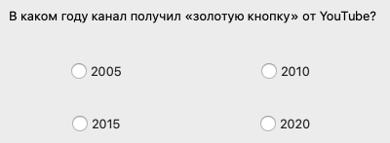
Positioning widgets using layouts
layoutH1 = QHBoxLayout()
layoutH2 = QHBoxLayout()
layoutH3 = QHBoxLayout()
layoutH1.addWidget(question, alignment = Qt.AlignCenter)
layoutH2.addWidget(btn_answer1, alignment = Qt.AlignCenter)
layoutH2.addWidget(btn_answer2, alignment = Qt.AlignCenter)
layoutH3.addWidget(btn_answer3, alignment = Qt.AlignCenter)
layoutH3.addWidget(btn_answer4, alignment = Qt.AlignCenter)
Brainstorming

Slide 49
Positioning widgets using layouts
layoutH1 = QHBoxLayout()
layoutH2 = QHBoxLayout()
layoutH3 = QHBoxLayout()
layoutH1.addWidget(question, alignment = Qt.AlignCenter)
layoutH2.addWidget(btn_answer1, alignment = Qt.AlignCenter)
layoutH2.addWidget(btn_answer2, alignment = Qt.AlignCenter)
layoutH3.addWidget(btn_answer3, alignment = Qt.AlignCenter)
layoutH3.addWidget(btn_answer4, alignment = Qt.AlignCenter)
layout_main = QVBoxLayout()
layout_main.addLayout(layoutH1)
layout_main.addLayout(layoutH2)
layout_main.addLayout(layoutH3)
Brainstorming

Slide 50
Positioning widgets using layouts
layoutH1 = QHBoxLayout()
layoutH2 = QHBoxLayout()
layoutH3 = QHBoxLayout()
layoutH1.addWidget(question, alignment = Qt.AlignCenter)
layoutH2.addWidget(btn_answer1, alignment = Qt.AlignCenter)
layoutH2.addWidget(btn_answer2, alignment = Qt.AlignCenter)
layoutH3.addWidget(btn_answer3, alignment = Qt.AlignCenter)
layoutH3.addWidget(btn_answer4, alignment = Qt.AlignCenter)
layout_main = QVBoxLayout()
layout_main.addLayout(layoutH1)
layout_main.addLayout(layoutH2)
layout_main.addLayout(layoutH3)
main_win.setLayout(layout_main)
Brainstorming

Slide 51
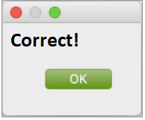
Creating a notification window
A window with a notification label and a ready-made "OK" button:
Method | Purpose
victory_win = QMessageBox() | A constructor that creates a notification window.
victory_win.setText('Correct!') | A method that displays the specified text in the window.
victory_win.exec_() | Leaves the window open.
Brainstorming
The button is created automatically.
Clicking on "OK" closes the window.

Slide 52
Radio button click handling
The customers want the following to happen:
when clicking on the correct radio button ("2005"), a window appears saying "Correct! You win a gyro scooter!”
when clicking on any other radio button, a window appears saying "No, it was in 2005. You win a company poster."
Brainstorming
How do we program this?

Slide 53
Button click handling
Possible solution. Write two processor functions.
the correct radio button responds to the processor function that creates a window with a message about winning;
the other radio buttons respond to the function that creates the window with the correct answer.
def show_win():
Brainstorming
btn_answer1.clicked.connect(show_win)
THE FUNCTION IS DESCRIBED SEPARATELY
NAME OF THE PROCESSOR FUNCTION WHICH THE BUTTON RESPONDS TO

Slide 54
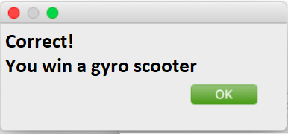
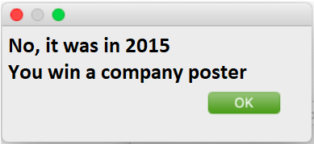
#...importing libraries
def show_win():
victory_win = QMessageBox()
victory_win.setText('Correct!\nYou win a gyro scooter')
victory_win.exec_()
def show_lose():
victory_win = QMessageBox()
victory_win.setText('No, it was in 2015.\nYou win a company poster')
victory_win.exec_()
#...creating an application and main window
#...creating question and answer widgets
#...creating layouts and adding widgets
btn_answer3.clicked.connect(show_win)
btn_answer1.clicked.connect(show_lose)
btn_answer2.clicked.connect(show_lose)
btn_answer4.clicked.connect(show_lose)
main_win.show()
app.exec_()
Brainstorming

Slide 55
Conclusions:
The QRadioButton widget is responsible for radio buttons, and the QMessageBox is responsible for notification windows.
Multiple widgets can be added to the same layout, and the layouts themselves can be nested within one another.
Brainstorming

Slide 56
Module 2. Lesson 2. Interface design
Visual Studio Code:
Competition

Slide 57
Complete the task in VS Code
VSC. Crazy people: competition
Visual studio code from Algorithmics
Creating your first application

Slide 58

Module 2. Lesson 2. Interface design
End of the
work day

Slide 59

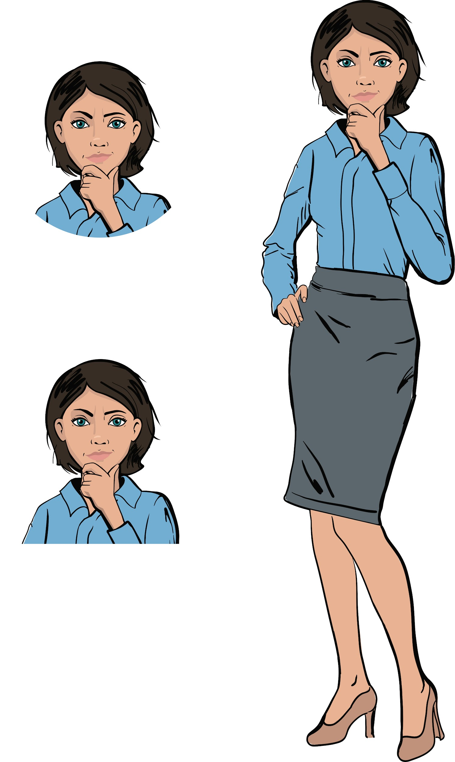
Let’s end the work day by
answering these technical questions:
What is a superclass? Inheritor class?
What does an inheritor class contain?
How does the PyQt library work?
What widgets did you learn today?
What is a layout? How do we position widgets using layouts?
Summing up
the work day
Cole,
senior developer
Emily,
project manager

Slide 60
Evaluating your work performance
Answer the questions with your colleagues:
What worked best?
What didn't work out the way you wanted?
What can you do to avoid setbacks next time?
Summing up
the work day

Slide 61
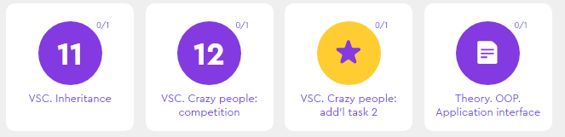
Additional tasks to improve your performance
VSC. Crazy People:
add’l task 2
Summing up
the work day

Slide 62
Publishing VS. Code projects
Laboratory

Slide 63
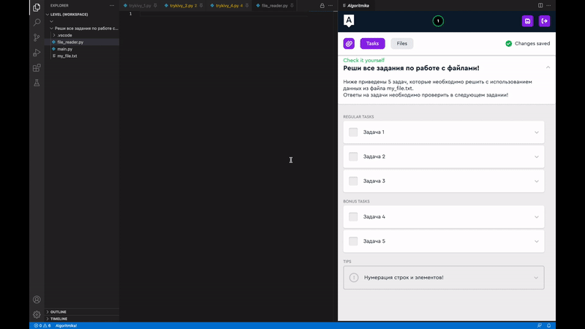

Save the project
1. Click on the icon
2. Enter the name. Use only Latin letters, numbers and the sign "_" The name should not be the same as other project names
Laboratory

Slide 64
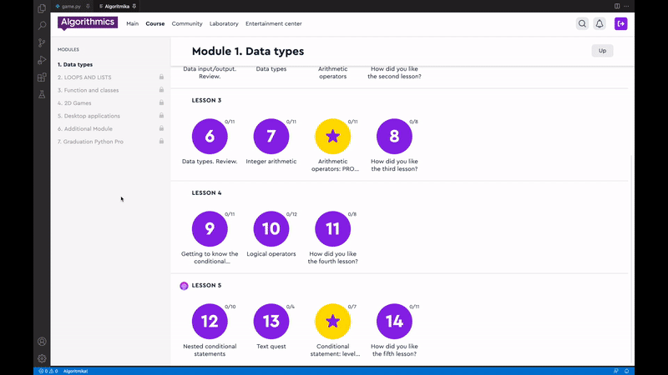
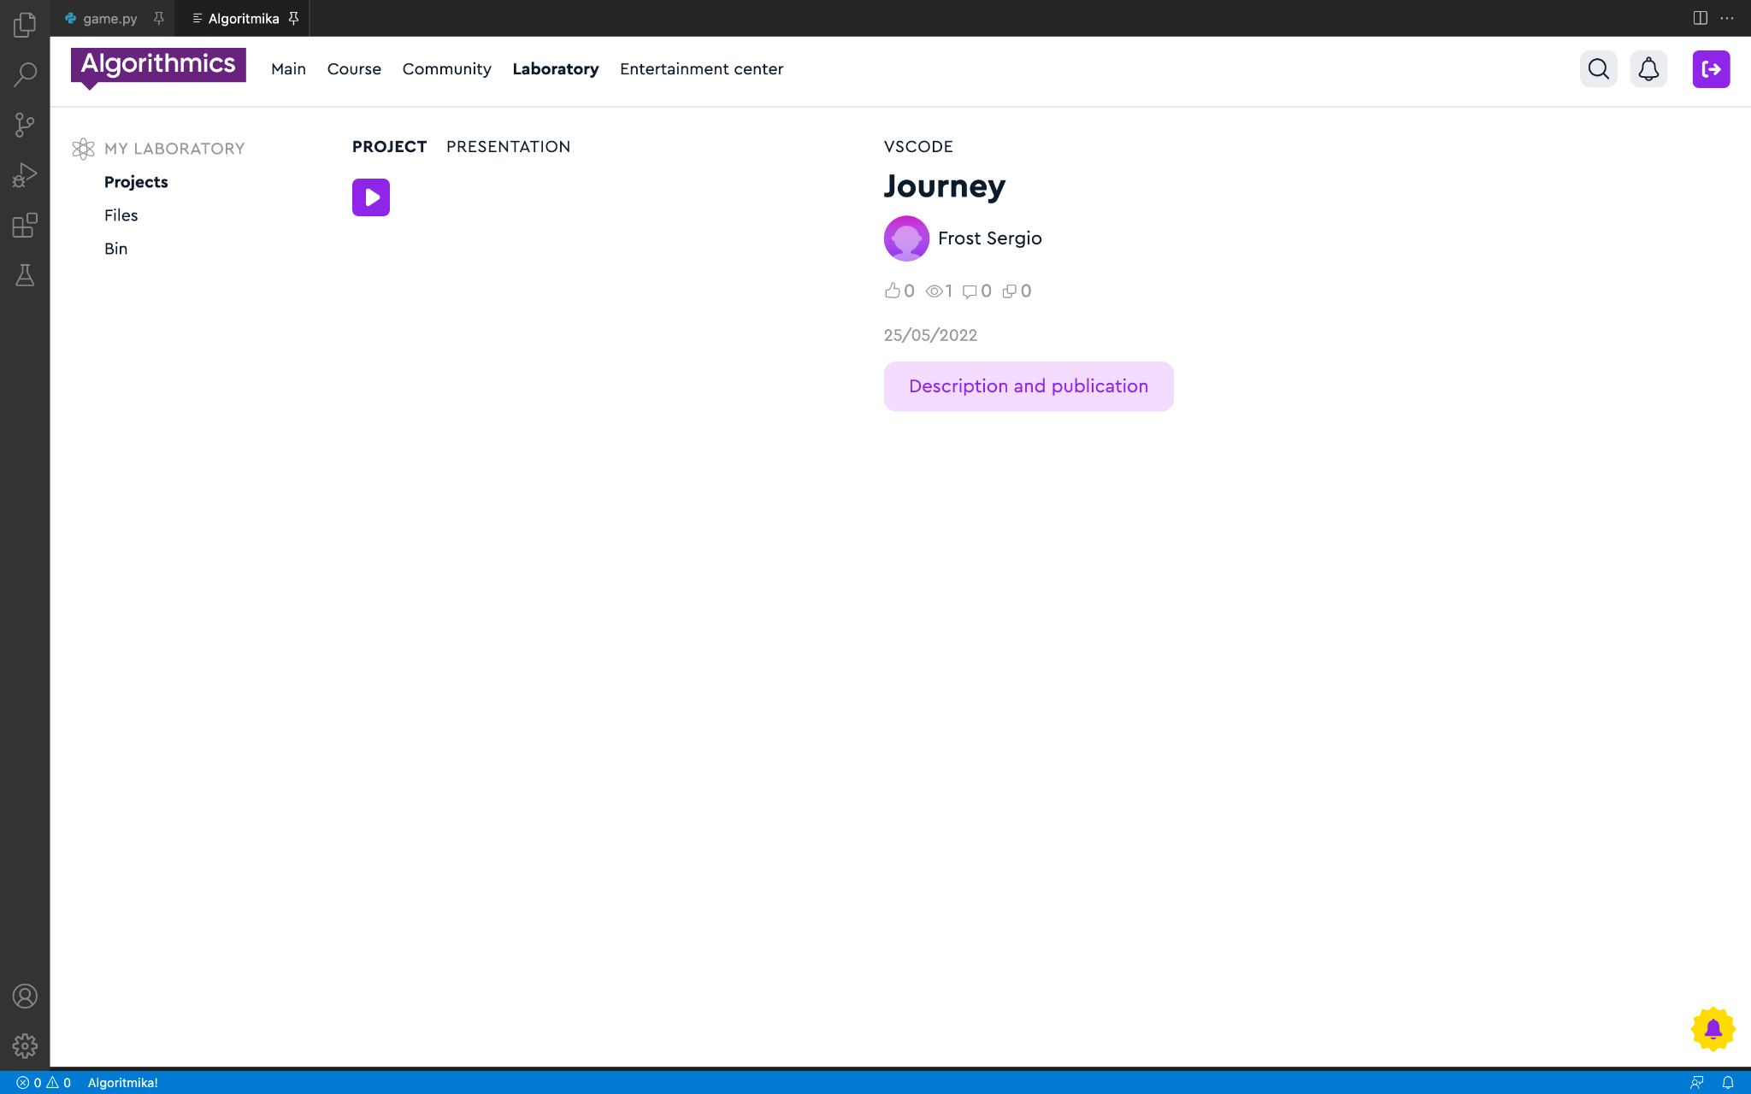
Go to the lab
Click on the project to proceed to editing the description and setting up the publication
Click the "Description and Publication" button
Laboratory

Slide 65
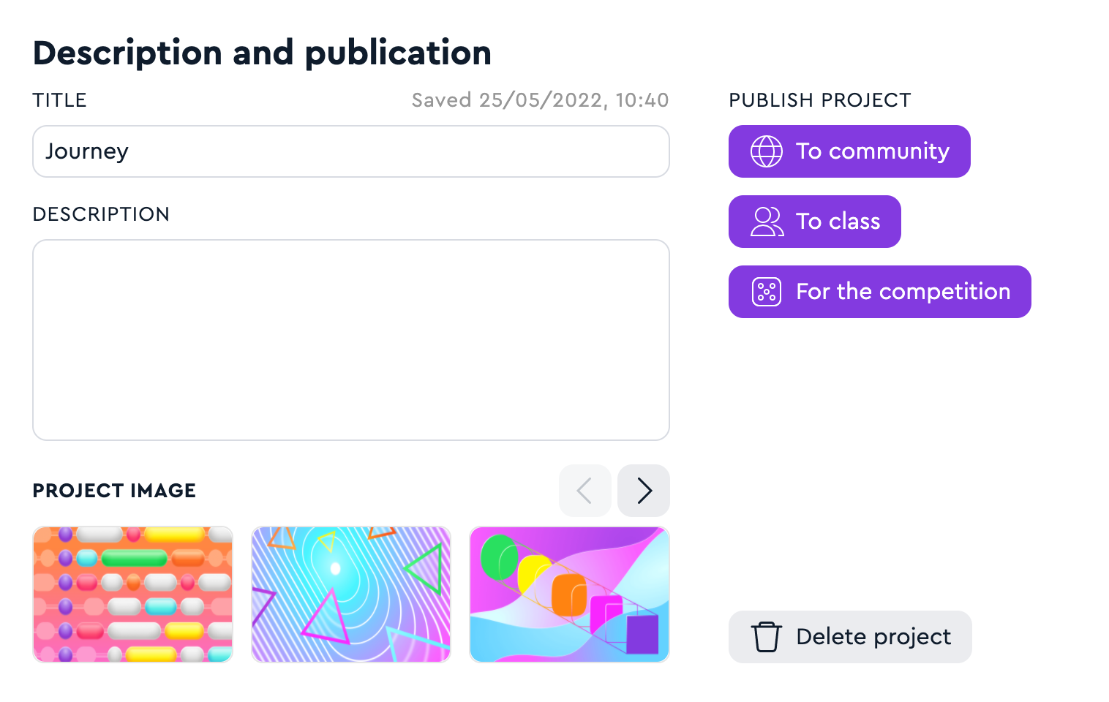
Add a description and publish
2. 1. Enter the name and description
2. 2. Publish your project to the Hall of Fame or Class
Laboratory

